Slide 1
Up-to-date ‘family planning’
Anne Connolly
The Ridge Medical Practice

Slide 2
Overview
Current state of play
CHC prescribing
LARC
Emergency contraception
What’s new

Slide 3
FSRH General Training Programmes
OPTIONAL LEARNING ROUTES TO PREPARE FOR KNOWLEDGE ASSESSMENT
eg eSRH, e-GP, RCGP ICSH, clinical guidelines, STIF course
eKA in SRH
(on-line Knowledge Assessment)
Course of 5
Assessment of Clinical Practice /
Reflection and Discussion of CP
eSRH module 18
eSRH module 17
DFSRH
NDFSRH
Model and clinical training and assessments
Model and clinical training and assessments
LoC IUT
LoC SDI
General Training Entry Requirements
GMC / NMC Number
Resuscitation & anaphylaxis training
Consultation Skills
DFSRH & LoC IUT: Bimanual & speculum examination
NDFSRH: Speculum examination
Learning
Assessment
Award of Qualification

Slide 4
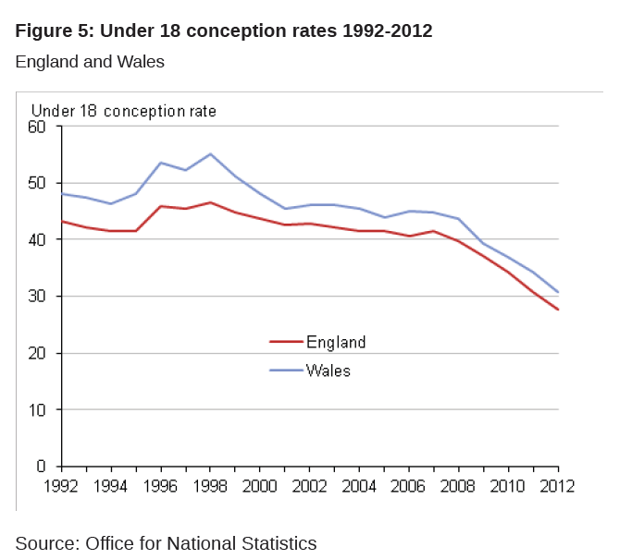
DoH Teen pregnancy
www.ons.gov.uk

Slide 5
Teenage pregnancy and LARC usage
Adjusted R²=0.91
P-value=0.002‡
A statistically significant association was observed between the increase of LARC usage in women aged 15-17 and the decrease of conception rates in that age group in England between 1998 and 2011
* Per 1,000 women aged 15-17
† In thousand cycles sold
‡ Multiple regression of LARC usage on under 18 conception rates adjusted for time – LARC coefficient estimate = -0.0104
Notes:
This graph shows the LARC usage in women under 18 (green line) and the under 18 conception rate (blue line). A statistically significant association was found between increasing LARC use and decreasing conception rates in women under 18.

Slide 6
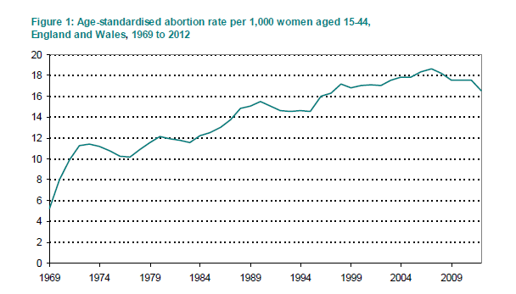
Age-standardised abortion rate
Abortion statistics, England and Wales 2012: www.gov.uk

Slide 7
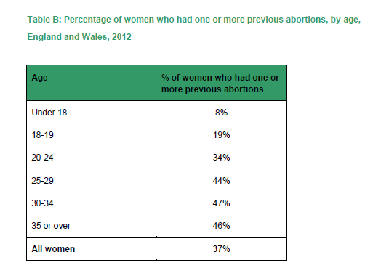
Repeat abortions
Abortion statistics, England and Wales 2012: www.gov.uk

Slide 8
Contraceptive effectiveness - most important reason for women choosing a contraceptive
Yet, women’s perception of efficacy may be inaccurate
Correct
Overestimate
Underestimate
Don’t know
Sterilisation
IUD
Implant
Injectable
Pills
Patch
Ring
Condoms
Fertility awareness
Nothing
IUD, intrauterine device.
Adapted from: Eisenberg DL, et al. Am J Obstet Gynecol 2012;206:479.e1–.e9.
Notes:
Contraceptive CHOICE project.
However, contraceptive effectiveness of the pill, patch and ring and injection is often overestimated by women.
Reference
Eisenberg DL, Secura GM, Madden TE, et al. Knowledge of contraceptive effectiveness. Am J Obstet Gynecol 2012;206:479.e1–.e9.

Slide 9
Primary care physicians’ perception of contraceptive efficacy is also inaccurate
Primary care physicians are also more likely to overestimate
efficacy of COCs and condoms too
Correct
Overestimate
Underestimate
IUDs
Injections
OCs
Condoms
Adapted from: Parisi SM, et al. Contraception 2012;86:48–54.
Notes:
doctors perceptions of their patients' risk of unintended pregnancy and perceptions of the relative effectiveness of contraceptive options is likely to influence the counselling they provide..
The Parsi analysis sought to assess perceptions among general internists and family physicians of the prevalence of unintended pregnancy in the United States, perceptions of rates of pregnancy when using no method of contraception and perceptions of the typical-use failure rates of available contraceptives.
PCPs were found underestimate failure rates with typical use of short acting methods:
85% underestimated the failure rate for OCs,
62% underestimated the failure rate for condoms and
16% underestimated the failure rate for injections.
(17% overestimated the failure rate of IUDs).
Reference
Parisi SM, Zikovich S, Chuang CH, Sobota M, Nothnagle M, Schwarz EB. Primary care physicians' perceptions of rates of unintended pregnancy. Contraception 2012;86:48–54.

Slide 10
Accidental pregnancy in first year of use – typical use
percent
Trussell J. 2011
Notes:
10

Slide 11

‘Doc I want the pill’
23 year old
Raynaud’s disease
Wants ‘the pill’
Can she?

Slide 12
CHC safety
Cardio-vascular risk
Thrombotic risk
Hepatic disease
Malignancy

Slide 13
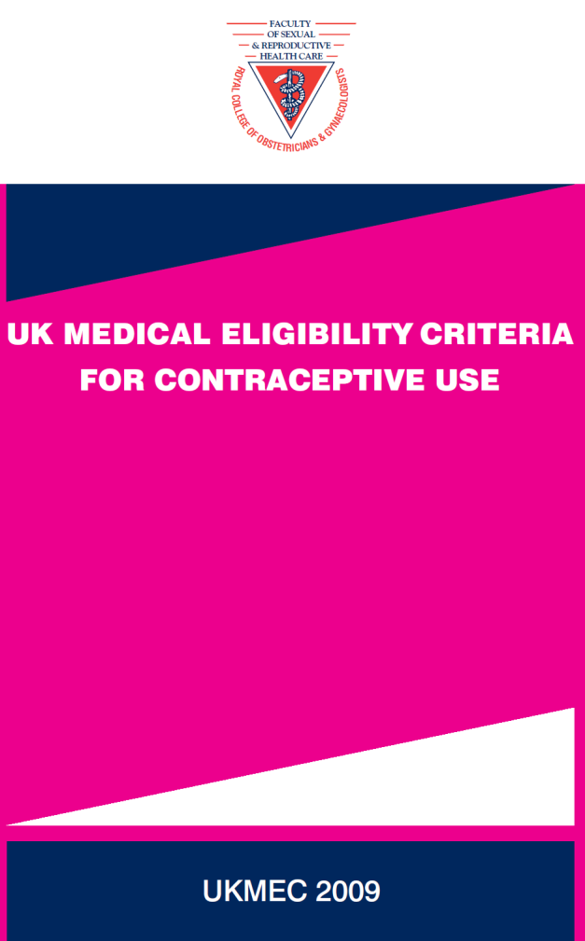
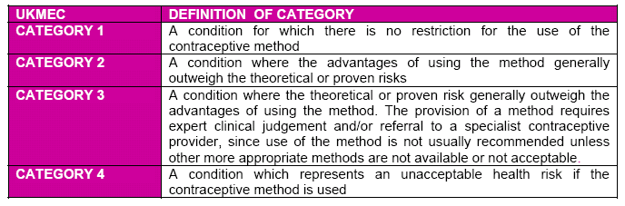
UKMEC

Slide 14
UKMEC 2009
Raynauds disease | CHC | POP | DMPA | IMP | Cu-IUD | IUS
Primary Secondary Without lupus anti-coagulant With lupus anti-coagulant | 1 2 4 | 1 2 2 | 1 1 2 | 1 1 2 | 1 1 1 | 1 1 2

Slide 15
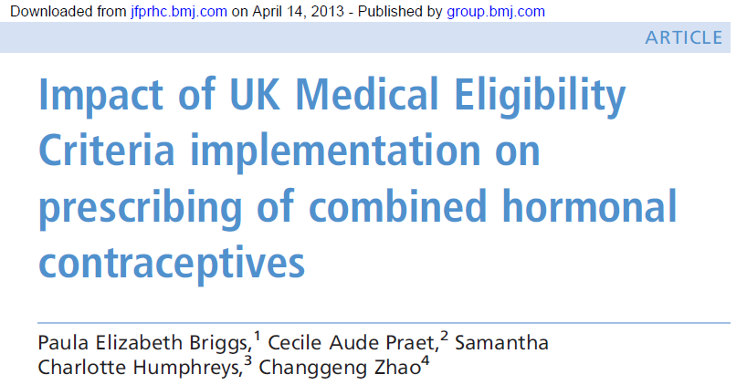
Improving CHC safety

Slide 16
Percentage of CHC Users with Category 3 or 4 Risk Factors Among All CHC Users Aged 15-49 in GPRD
Results
Among CHC users, a statistically significant decrease in the proportion with category 3 or 4 risk factors was found, from 8.1% before publication of UKMEC (2005) to 7.26% after its publication (2010) (p<0.001).

Slide 17
Percentage of High Risk CHC Users with Each Specific Risk Factor Studied (2005 and 2010)
Results
The most common category 3 or 4 risk factors among women using CHCs over the whole study period were hypertension, BMI≥35 and current (CS)/past (PS) year smoking in women≥35 years.

Slide 18
It’s really about the woman, rather than ‘the pill’
Personal / family history of VTE
Genetic mutations affecting coagulation (e.g., thrombophilia)
Increasing age
Obesity (BMI ≥30 kg/m²)
Recent starter or switcher
Pregnancy / post-partum period
Use of oestrogen-progestogen combination products (e.g., COCs)
Leg surgery
Major surgery
Major trauma
Prolonged immobility
Notes:
Reference
Anderson FA, Jr., Spencer FA. Risk factors for venous thromboembolism. Circulation 2003;107(23 Suppl 1):I9–16.

Slide 19
EURAS results: Impact of age and BMI on VTE risk during OC use
BMI
VTE/10,000 WY
Age
* Risk estimates based on 115 VTE in 116,00 WY of exposure
Rabe T, Luxembourg B, Ludwig M, Dinger J, et al. J Reproduktionsmed Endokrinol 2011; 8: 126-167
Notes:
And this illustrates the importance of BMI and age. You can see that if you have a BMI over 30, even if you are under 25 years old , your risk is 22.9/10,000.
If you are between 25 and 39, it rises to 33 and for a woman over 40 with a BMI over 30, the risk is 57/10,000.
However, a woman with a BMI, under 25, who is over 40 years old, has a risk of 19/10,000. So age and BMI are both important risk factors.
19

Slide 20

Progestogen | VTE cases per 10,000 women per year
NO Combined hormonal contraception or pregnancy | 2
Levonorgestrel, norethisterone or norgestimate | 5-7
Etonorgestrel or Norelgestromin | 6-12
Gestodene, desogestrel, drosperinone | 9-12
Chlormadinone, dienogest, nomegestrol | Studies ongoing

Slide 21
MRHA Feb 2014
Combined hormonal contraceptives and VTE review confirms risk is small—consider risk factors and remain vigilant for signs and symptoms
Results of review:
The risk of blood clots with all low-dose CHCs is small
There is good evidence that the risk of venous thromboembolism (VTE) may vary between products, depending on the progestogen
  CHCs that contain levonorgestrel, norethisterone, or norgestimate have the lowest risk of VTE
  The benefits of any CHC far outweigh the risk of serious side effects
  prescribers and women should be aware of the major risk factors for
  thromboembolism, and of the key signs and symptoms

Slide 22
COCPs
Less androgenic
 | Yasmin
Femodette | Femodene | Cilest
 | Microgynon 30 | Ovysmenn
More estrogenic

Slide 23
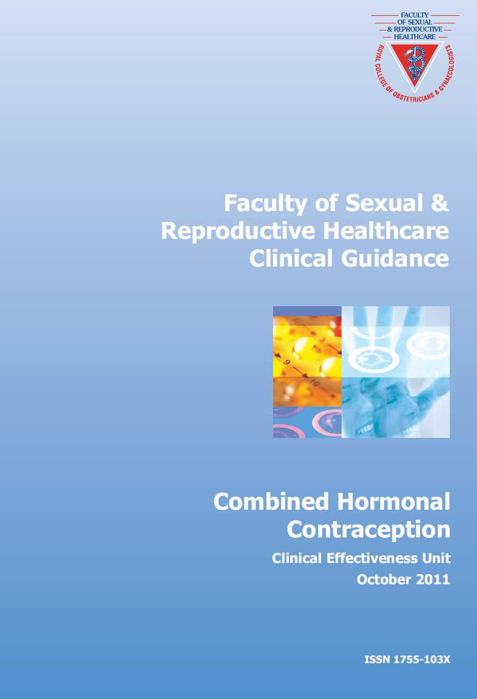
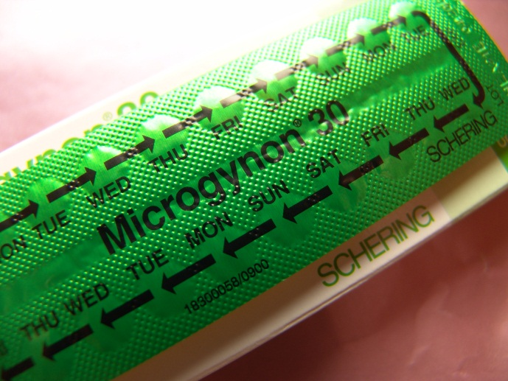
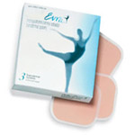

FSRH CHC guidance
Extended regimens
Reduced ‘pill-free’ interval

Slide 24
Tailored regimens
Regimen | Treatment days | Break days | Length of cycle | Bleeds per year
Traditional | 21 | 7 | 28 | 13
Tricycling | 63 | 7 | 70 | 5
Shorter break | 21 | 4 | 25 | 15
Continuous use | Until break-through bleeding | 7 | Varies according to individual | Varies according to individual
Continuous use and shorter break | Until break-through bleeding | 4 | Varies according to individual | Varies according to individual

Slide 25
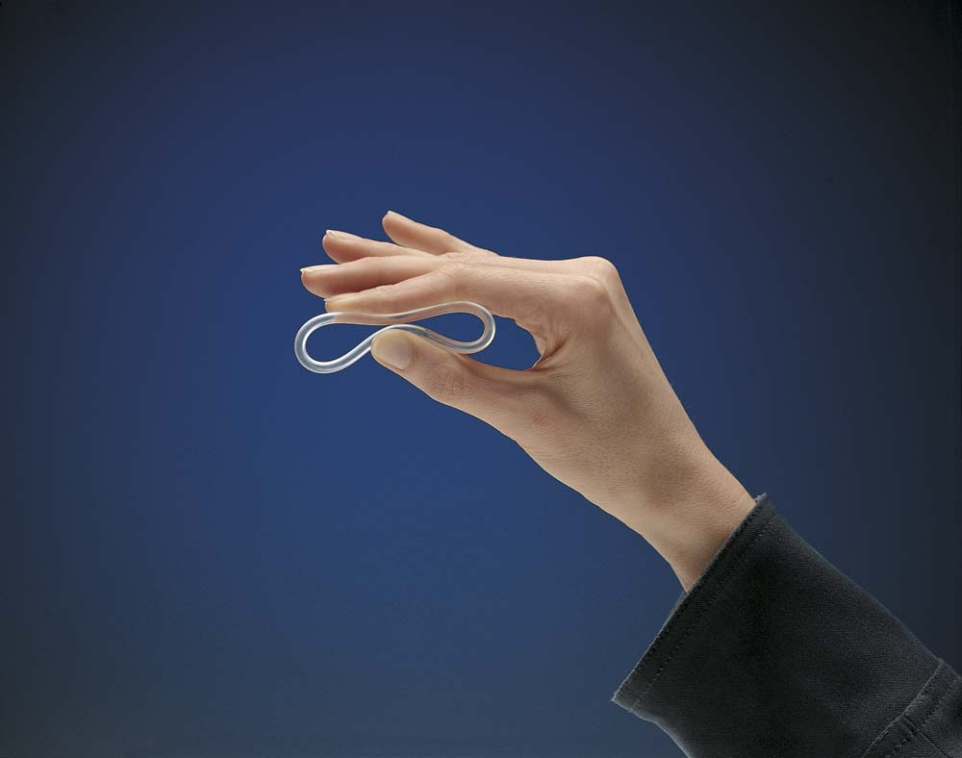
NuvaRing®
Daily release:
15 µg ethinylestradiol plus 120µg etonogestrel
Once a month method
  1 ring for 3 weeks
  1 ring-free week
Lowest dose and exposure to EE compared to COC
Notes:
The vaginal ring (NuvaRing) is a monthly method that releases 15 µg of ethinylestradiol and 120 µg of etonogestrel daily.
Each ring is placed in the vagina for 3 weeks.
A hormone-free week and a withdrawal bleed follows.
The vaginal ring offers the lowest dose and exposure to oestrogen of all hormonal contraceptive methods.
NuvaRing is available in the UK. It is registered in over 30 countries worldwide, including the USA and many EU countries.
Reference
van den Heuvel MW, van Bragt AJM, Alnabawy AKM, Kaptein MC. Comparison of ethinylestradiol pharmacokinetics in three hormonal contraceptive formulations: the vaginal ring, the transdermal patch and an oral contraceptive. Contraception 2005 ;72:168–174.

Slide 26
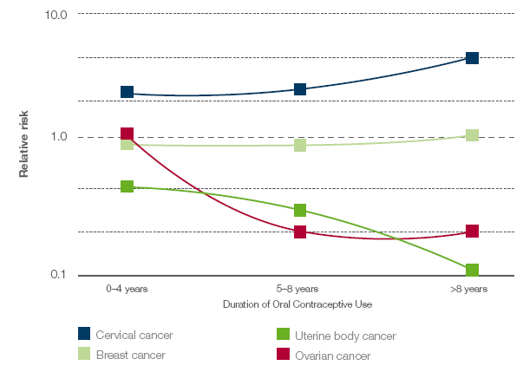
Gynaecological cancers and COC use
Relative risk
0–4 years
5–8 years
>8 years
Duration of OC use
Counselling point
COCs appear to have little / no effect on breast cancer risk
Vessey & Painter. Br J Cancer 2006;95(3):385–9
Notes:
Most of the OCs used in the study were estrogen-containing (50 µg) COCs; only 3% of women were using progestin-only OCs. Data were generated using a cohort of women in the UK.
Meta-analyses and observational studies have, for the most part, failed to show a robust association between COC use and breast cancer.¹⁻⁶ At worst, the studies showed only a small effect of COCs on the incidence of breast cancer, and any effect gradually declined over time following COC cessation.
COCs appear to have little or no effect on the risk of breast cancer. In instances where an increased risk was identified, this reduced over time following COC discontinuation.
References
Breast cancer and hormonal contraceptives: collaborative reanalysis of individual data on 53 297 women with breast cancer and 100 239 women without breast cancer from 54 epidemiological studies. Collaborative Group on Hormonal Factors in Breast Cancer. Lancet 1996;347(9017):1713–27.
Kahlenborn C, Modugno F, Potter DM, Severs WB. Oral contraceptive use as a risk factor for premenopausal breast cancer: a meta-analysis. Mayo Clin Proc 2006;81(10):1290–302.
Vessey M, Painter R. Oral contraceptive use and cancer. Findings in a large cohort study, 1968-2004. Br J Cancer 2006;95(3):385–9.
Marchbanks PA, McDonald JA, Wilson HG, Folger SG, Mandel MG, Daling JR, Bernstein L, Malone KE, Ursin G, Strom BL, Norman SA, Weiss LK. Oral contraceptives and the risk of breast cancer. N Engl J Med 2002;346(26):2025–32.
Heinemann LAJ, Lewis MA, Kühl-Habich D, Braendle W, Moehner S (on behalf of the German Cohort Study on Women’s Health Research Group). The risk of breast tumours and lifetime history of oral contraceptive use [article in German]. Geburtsh Frauenheilk 2002;62(8):750–7.
Hannaford PC, Selvaraj S, Elliott AM, Angus V, Iversen L, Lee AJ. Cancer risk among users of oral contraceptives: cohort data from the Royal College of General Practitioner's oral contraception study. BMJ 2007;335(7621):651.

Slide 27
LARC

Slide 28
CHOICE study
Contraceptive method choices after counselling (N=2,500)¹
Long-acting
Shorter-acting
33%
67%
LARC=long-acting reversible contraceptive.
Secura GM et al. Am J Obstet Gynecol. 2010;203:115.e1–115.e7
Mestad et al. Contraception 2011;84:495-8.
69% of 14-17 year-olds chose a LARC with 63% of these choosing an implant²
Notes:
Draft: Not Approved for Use
The Contraceptive CHOICE Project has demonstrated that women will choose long-acting reversible contraceptives (LARCs) over other contraceptive options when fully informed about their options.¹
Among 2,500 women who were either not using contraception or were willing to switch to a different method, 67% choose a LARC and only 33% chose a shorter-acting method. The LARCs chosen included the subdermal implant, the levonorgestrel intrauterine system, and the copper-bearing intrauterine device. The shorter-acting agents principally included oral pills, the vaginal ring, injectables, and the patch.¹
These results show that “forgettable contraception” with LARCs has a greater than expected appeal to many women and therefore support offering LARCs to women seeking effective contraception.¹
MS28
1. Secura GM et al. Am J Obstet Gynecol. 2010;203:115.e1–115.e7.
WOMN-1014325-0000

Slide 29
They liked it after 12 months......
Contraceptive CHOICE project
Proportion of women, %
®
LARC
Short-acting reversible contraception
Peipert et al. 2011
Notes:
Highlight the findings in bar chart to the audience: IUS has the longest continuation rate = 87.5% @ 12 months
Reference
Peipert JF, Zhao Q, Allsworth JE, et al. Continuation and satisfaction of reversible contraception. Obstet Gynecol 2011;117:1105−1113.

Slide 30
....and after 24 months...
Contraceptive CHOICE project
Proportion of women, %
®
LARC
Short-acting reversible contraception
Peipert et al. 2011
Notes:
Highlight the findings in bar chart to the audience: IUS has the longest continuation rate = 87.5% @ 12 months
Reference
Peipert JF, Zhao Q, Allsworth JE, et al. Continuation and satisfaction of reversible contraception. Obstet Gynecol 2011;117:1105−1113.

Slide 31
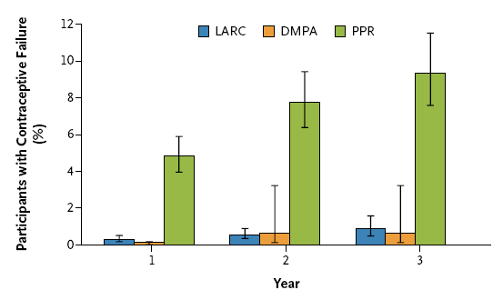
......and they work!
Pill Patch Ring
Winner et al. N Eng J Med 2012

Slide 32
.....especially in youngsters
LARC, age ≥21 years
1.00
0.95
0.90
0.85
LARC, age <21 years
Probability of not having an
unintended pregnancy
Pill, patch or ring, age ≥21 years
Pill, patch or ring, age <21 years
0.00
0 50 100 150 200
Week
Winner B, et al. N Engl J Med 2012;366:1998–2007.
Notes:
Women aged <21 years using pills, patch or ring had almost twice the risk of unintended pregnancy as older women (hazard ratio 1.9; 95% CI 1.2–2.8; p=0.02).
This shows the need for effective contraception in young patients is as important as older patients
Reference
Winner B, Peipert JF, Zhao Q, et al. Effectiveness of long-acting reversible contraception. N Engl J Med 2012;366(21):1998–2007.

Slide 33

‘Bovvered’
‘The injection is making me fat Doc’

Slide 34
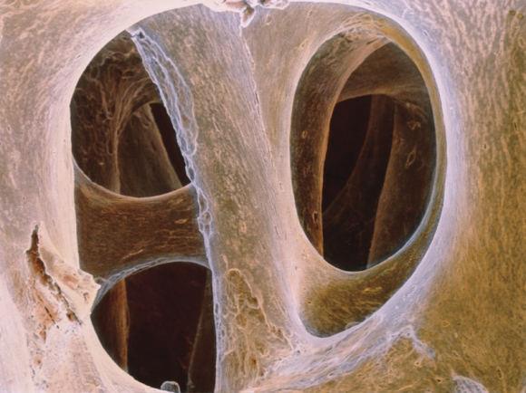
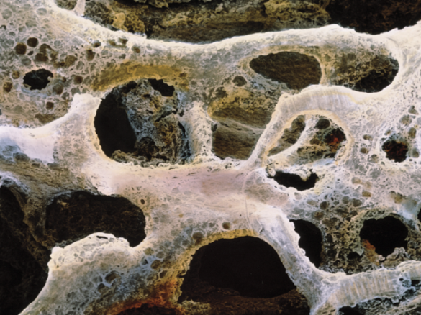
And what about fractures?
312,395 women in GPRD, aged 15-50
  53% with at least 6/12 baseline data
  Average FU 5.4 – 5.9 years
Women who chose DMPA had more fractures BEFORE using DMPA than non-users (RR 1.28 (95% CI 1.07-1.53))
Long term DMPA users had lower fracture risk than short term users
Association does not appear to be causal
  ‘focus more on violence prevention’ (Schwarz 2013)
Lanza et al. Obstet Gynecol 2013: ;121:593–600
Notes:
An update on Depo Provera and fracture risk.
There has been a recent analysis of 18 years of data from the General Practice Research Database. The investigators identified over 300,000 women with prescriptions for contraception. Over 11,000 fractures were identified in DMPA users and nonusers. The average length of FU was between 5 and a half and 6 years.
Overall, absolute fracture rates remained below 1 per 100 woman-years in DMPA users. Analysis of a subcohort of 166,000 women with 6 months of baseline history showed that before they initiated contraception, women who chose DMPA had higher fracture risk than those who chose other forms of contraception. After initiation of DMPA use, fracture risk did not increase.
In addition, women who received 8 DMPA injections had lower fracture risk than those who received fewer DMPA injections.
DMPA users were more likely than nonusers to sustain traumatic fractures.
This study has led one commentator to write: These data suggest that those who are interested in promoting bone health might do well to focus more on violence prevention than on limiting contraceptive use. ‘
34

Slide 35
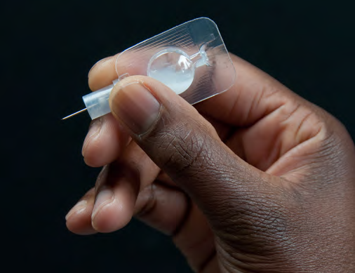
Sayana Press …
Sayana Press
  104 mg/ml MPA for subcutaneous injection
  Similar clinical effects as IM
Pilots in Scotland and Florida for self administration
  Acceptable
  Easy to administer
  Continuation rates similar in both groups
  Local skin reactions about 10%
  Using syringe/needle not Uniject
Prabhakaran & Sweet. Contraception 2012; 85:458-64:
Cameron et al. J Pediatr Adolesc Gynecol.2011;24:317-9

Slide 36

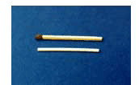
Nexplanon®
Advantages
First year user failure rate: 0.05
Long lasting – up to 3 years
Independent of intercourse
Can be used during breast feeding
Useful for women who cannot take oestrogen
Baseline fertility levels return after removal
Disadvantages
Changes in bleeding patterns likely
Hormonal side effects (e.g. acne, headaches, breast tenderness)
Does not protect against STI’s
Must be fitted by trained professional
Interactions with enzyme inducers

Slide 37
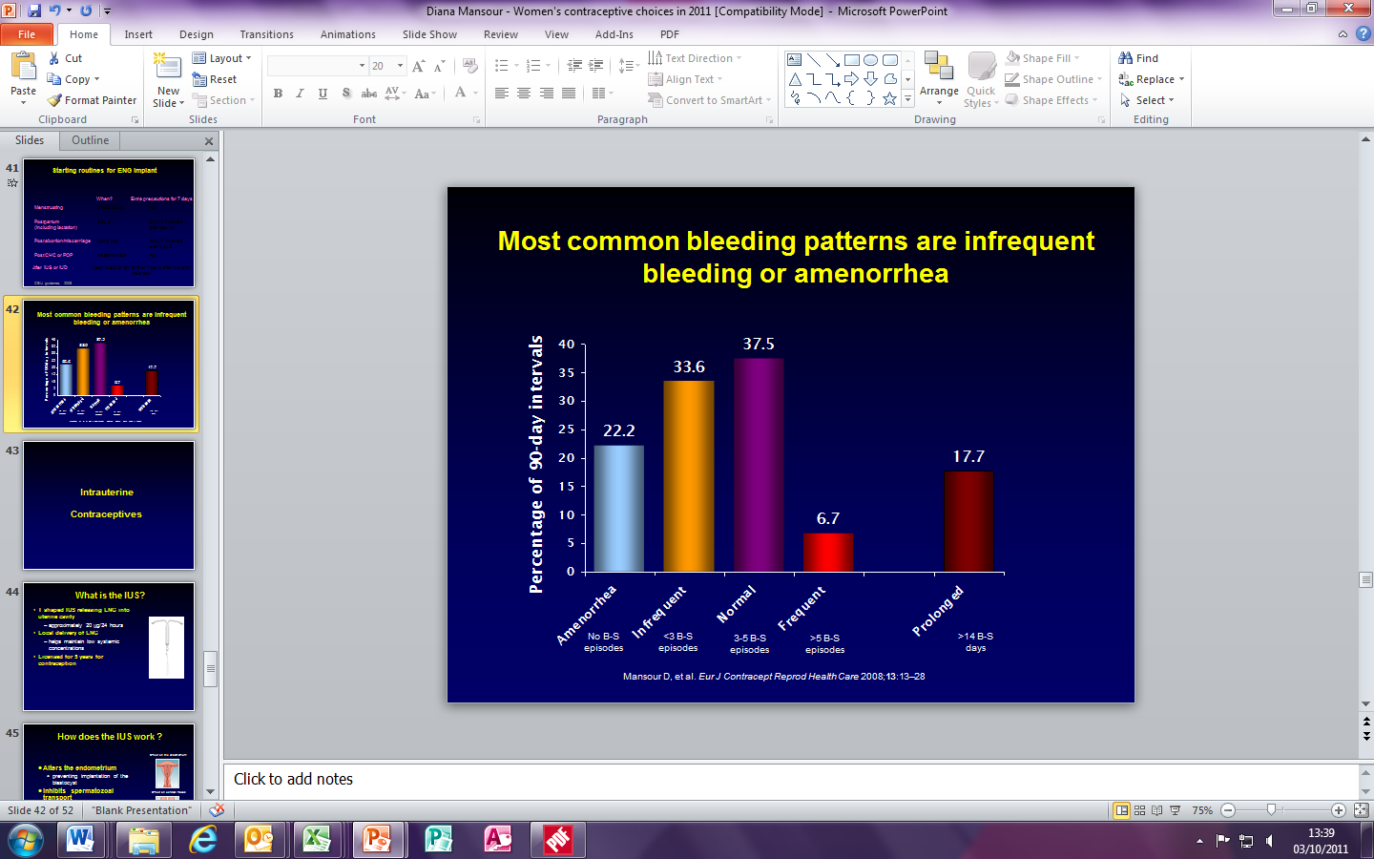
Bleeding patterns with Nexplanon
No B-S episodes
<3 B-S episodes
3-5 B-S episodes
>5 B-S episodes
>14 B-S days
Mansour D, et al. Eur J Contracept Reprod Health Care 2008;13:13–28

Slide 38
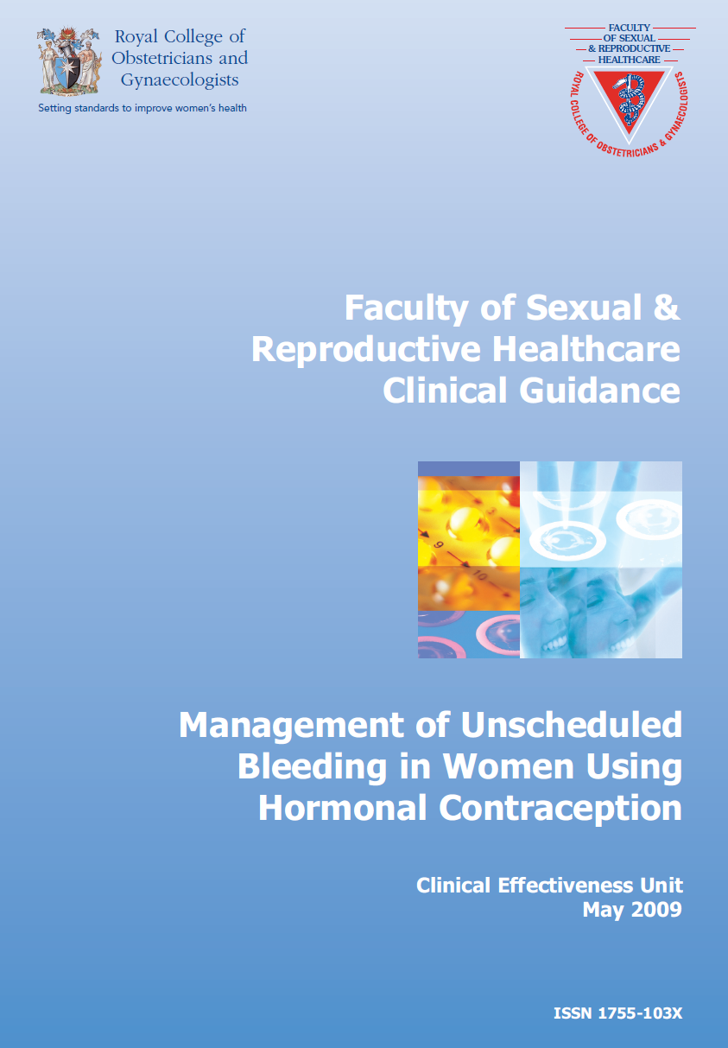
Management of bleeding problems with Nexplanon
Pre-insertion counselling important
Exclude pathology
Drug treatments
  COC cyclically for 2-3 months
  Progestogens –MPA 10mgs bd for 3 months
  POP- Cerazette
  NSAID for 5-10 days
  Tranexamic acid 500mg twice daily for 5 days
Return of bleeding likely when treatment stopped

Slide 39

‘Doc I want the pill’
47 yr old
New relationship
Heavy periods

Slide 40
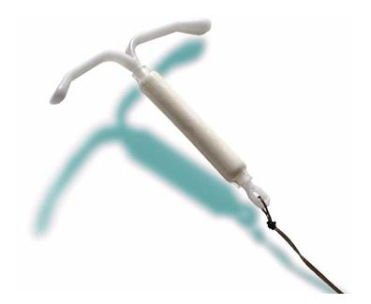
Mirena®
Uses:
  Contraception
  Management of Heavy Menstrual Bleeding
  HRT
  Plus:
    Endometrial protection
    Management of simple hyperplasia

Slide 41
Mean bleeding/spotting days in women with IUS fitted for heavy menstrual bleeding
30.0
27.5
25.0
22.5
20.0
17.5
15.0
12.5
10.0
7.5
5.0
2.5
0.0
Spotting only days
n=151
Bleeding days
n=149
Number of days %
n=142
n=144
n=129
n=50
n=49
n=90
n=47
n=47
n=39
n=31
Baseline
1
2
3
4
5
6
7
8
9
10
11
12
Year
Adapted from: Jensen et al. Contraception 2013

Slide 42
Mean bleeding/spotting days in women
with IUS fitted for contraception
40
35
30
25
20
15
10
5
0
Spotting only days
Bleeding days
Number of days
1
2
3
4
5
6
7
8
9
10
11
12
90 day reference periods over 3 years
Amenorrhoea
- at 6 months 5.9%
- at 3 years 23.6%
Adapted from: Gemzell-Danielsson et al. Fertil Steril 2012

Slide 43

‘Doc I’ve had an accident’
33 year old
Burst condom
BMI 35
Wants the morning after pill

Slide 44
Management of a request for
Emergency Contraception
What do you need to know?
Consider possibility of an implanted pregnancy
Timing of episode(s) of UPSI ?
LMP or withdrawal bleed ?
Potential drug interactions?
Medical eligibility?
Explain all method options
Discuss on-going contraception
Discuss STIs
Arrange any necessary referral/follow-up

Slide 45
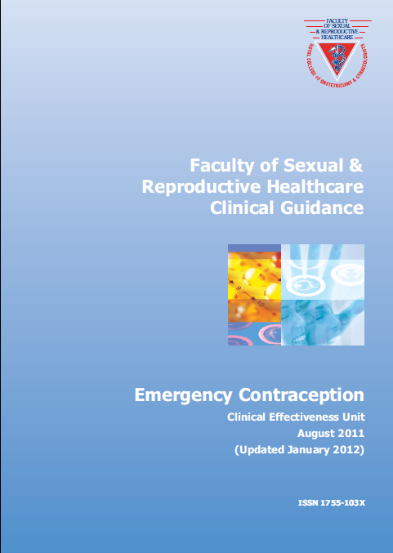
Emergency contraception
Cu- IUD
Levonelle
Ella-One

Slide 46
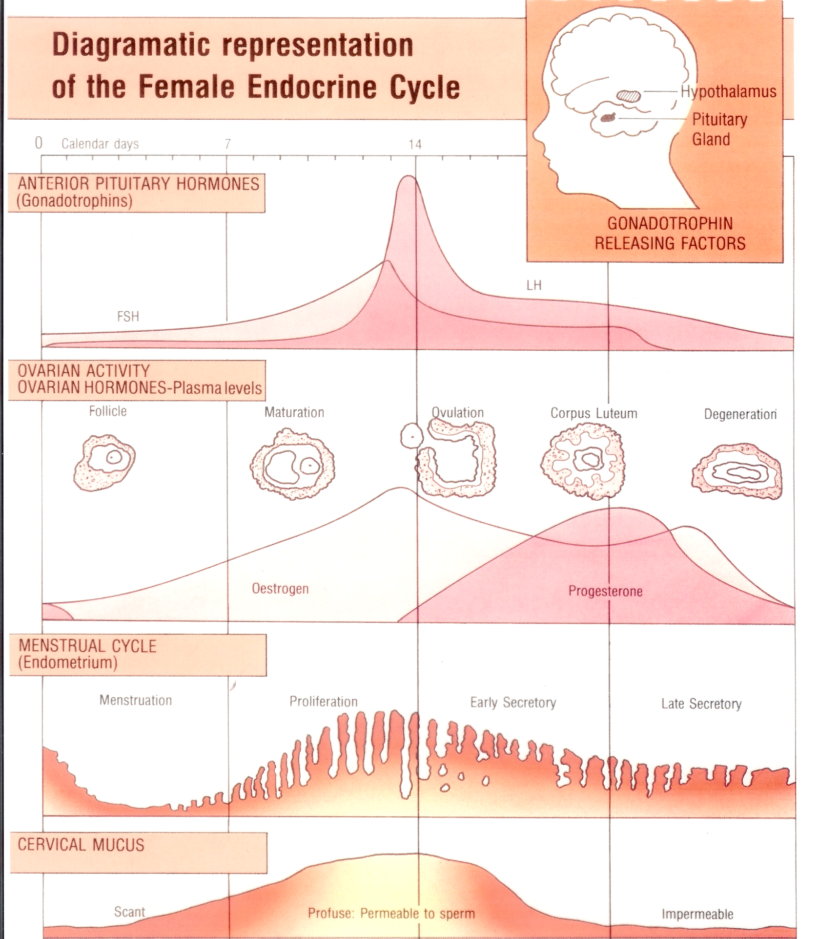
When in the cycle is the risk highest?
Max risk
Notes:
This is the normal cycle and there is a risk of pregnancy in the days leading up to ovulation, but very soon afterwards there is no further risk until the next cycle. The difficulty in the real world is that the ovulation date can be difficult to predict. The max risk for pregnancy is from SI in the two days leading up to ovulation. Implantation is an active process which starts around day 6 after fertilisation.

Slide 47
A global, online survey of HCPs’ attitudes and beliefs regarding IUC
Most frequently reported barriers to considering IUC for women in general:
  Nulliparity
  Concern about PID
Most frequently reported barriers to considering IUC for nulliparous women:
  Concern about difficult insertion
  Concern about PID
  Concern about insertion pain
None of these barriers are evidence-based

Slide 48
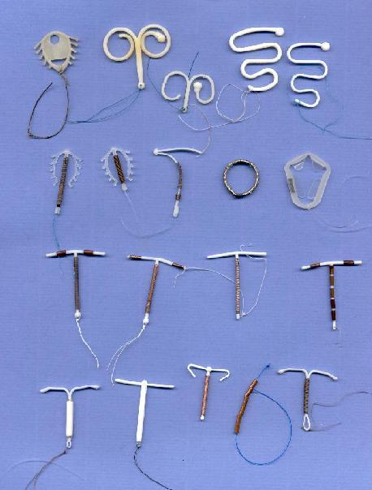
Notes:
Anecdotal evidence of the use if intrauterine contraceptive devices dating back to the end of the 19th century.
1962 – At the first International Conference on IUDs in New York the Lippes Loop was presented by its inventor and became the standard inert device.
Bioactive devices developed which contain copper or levonorgestrel.
Frameless device - GyneFix.
The term ‘coil’ and ‘loop’ should be avoided and replaced with the more correct term ‘IUD’.
Now used by an estimated 110 million women worldwide, more than half of which are in China. In UK only 5% of women using contraception choose this method. Use in UK is increasing.

Slide 49

Intrauterine contraception and nulliparous women
Use
  patient choice
  complex medical problems e.g. cardiovascular disease, HIV,
  taking liver enzyme inducers
Safety in nullips
  no evidence of increased risk of expulsion, pelvic infection or infertility
  well-accepted (80% for IUS versus 73% in COC group at 12 months)
  easily fitted
  Pakarinen, Contraception, 2003;
  Prager et al. Contraception 2007
Notes:
49

Slide 50
Evidence in relation to pain on insertion
Even among first-time users, pain from IUD insertion is generally low
Pain VAS
0
1
2
3
4
5
6
7
8
9
10 cm
No pain
Nulliparous women (2.7)
Worst pain
imaginable
Parous women (1.9)
VAS, visual analogue scale.
Adapted from: Hubacher D, et al. Am J Obstet Gynecol 2006;195:1272−7.
Notes:
There is a misperception that nulliparous women experience considerable discomfort during and after placement of intrauterine contraception (IUC) [1–3]. However, this perception is not evidence-based.
There are few data directly comparing placement-related pain in nulliparous vs parous women.
In a study of 2019 first-time users of the copper intrauterine device (Cu-IUD), placement-related, pain as measured on a 10 cm visual analogue scale (VAS), was rated as low by both nulliparous and parous women [4]. Furthermore, the mean pain scores on the same VAS were similar in the two groups of women, being 2.7 cm for the nulliparous women and 1.9 cm for the parous women. Both of these scores are low [4].
References
Lyus R, Lohr P, Prager S, on behalf of the Board of the Society of Family Planning. Use of the Mirena LNG-IUS and ParaGard CuT380A intrauterine devices in nulliparous women. Contraception 2009;81:367−71.
Allen RH, Goldberg AB, Grimes DA. Expanding access to intrauterine contraception. Am J Obstet Gynecol 2009;201:456.e1−e5.
Middleton AJ, Naish J, Singer N. General Practitioners’ views on the use of the levonorgestrel-releasing intrauterine system in young, nulligravid women, in London, UK. Eur J Contracept Reprod Health Care 2011;16:311−18.
Hubacher D, Reyes V, Lillo S, Zepeda A, Chen PL, Croxatto H. Pain from copper intrauterine device insertion: randomized trial of prophylactic ibuprofen. Am J Obstet Gynecol 2006;195:1272−7.

Slide 51
UPSI and oral emergency contraception failure
Failure %
Glasier et al. Contraception 2011

Slide 52
Weight and oral emergency contraception failure
Failure %
Glasier et al. Contraception 2011

Slide 53
Failure rate for levonorgestrel EHC
Weight (kg) | <55 | 55-65 | 65-75 | 75-85 | ≥85
Total number of women | 349 | 608 | 426 | 155 | 193
Number of pregnancies | 3 | 8 | 6 | 10 | 11
Pregnancy rate | 0.9% | 1.3% | 1.4% | 6.4% | 5.7%
Confidence interval | [0.2-2.5] | [0.6-2.6] | [0.5-3.0] | [3.1-11.5] | [2.9-10.0]
Irish SmPC for Norlevo www.medicines.ie/searchresults.aspx?term=norlevo&searchtype=AdvancedSearch

Slide 54
Further intercourse in cycle and oral emergency contraception failure
Failure %
Glasier et al. Contraception 2011
Notes:
Rest my case for quick start

Slide 55
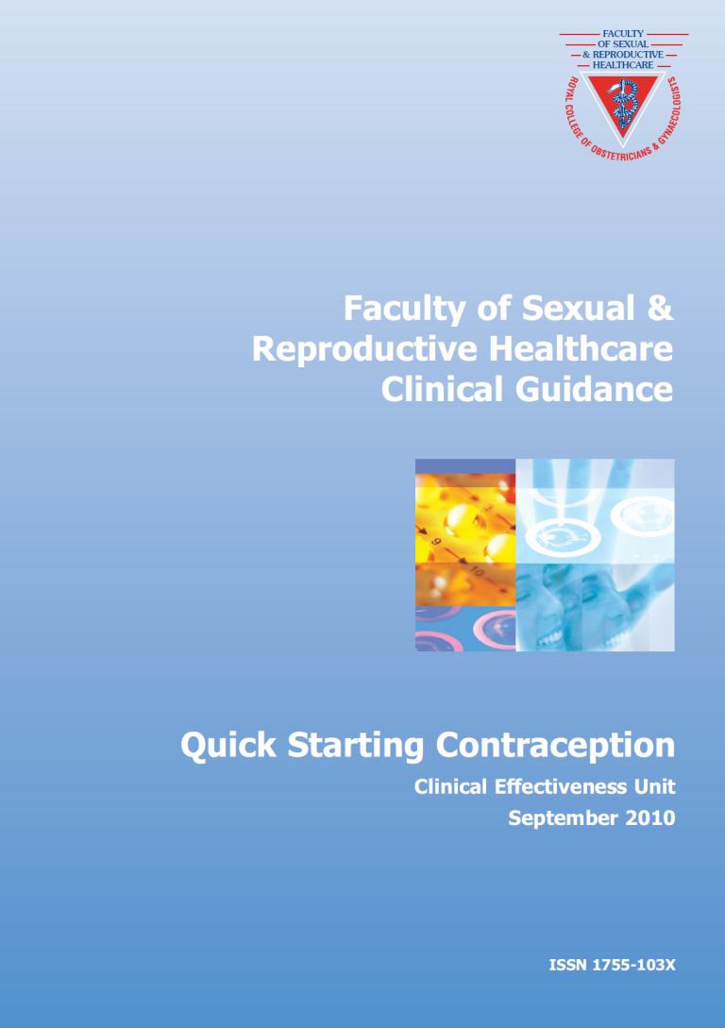
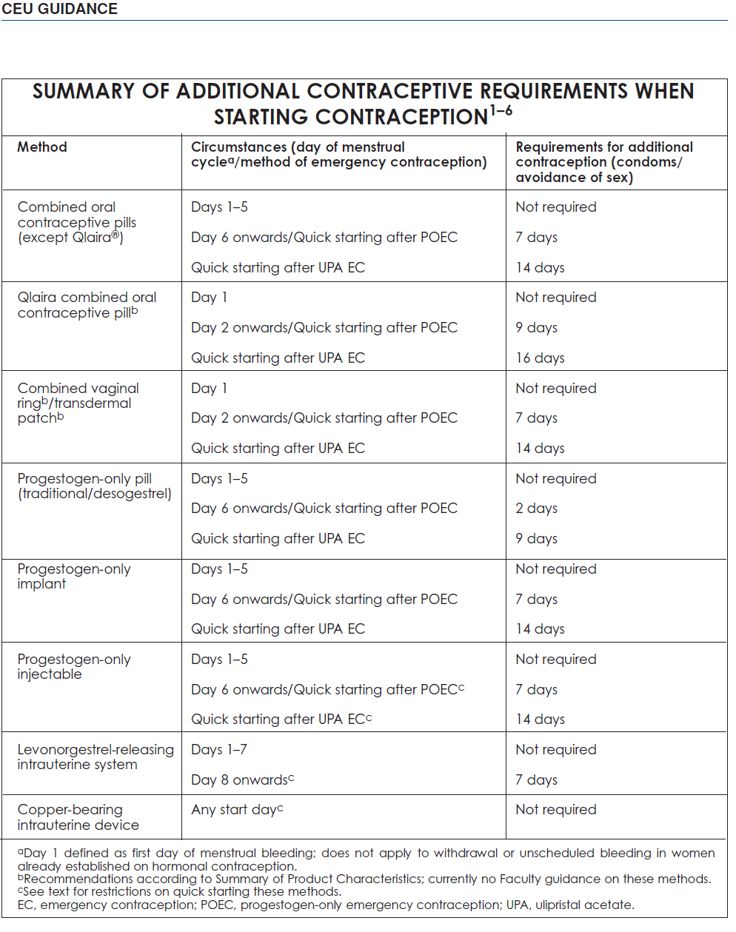
Quick Starting

Slide 56
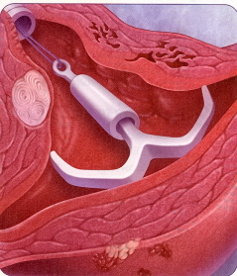
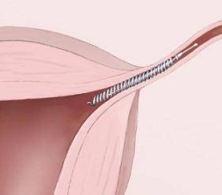
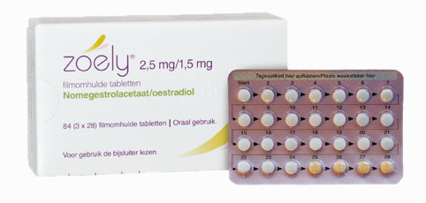
New products

Slide 57
Improving compliance
Offering choices
Right product, right time
Managing expectations
Counselling re side effects
Managing adverse effects
Motivational interviewing!

